Slide 1
A RULE-BASED CHATBOT
(A domain-specific assistant for FAQ)
TEAM NAME:-CHATBOT INNOVATORS

Slide 2
Rule-Based Chatbot
About our Team
Team Name:- Chatbot Innovators
Project Title:- A Rule-Based Chatbot( Domain-specific assistant for FAQ)
Team Members & Role:-
Ayushi ( Team leader)
Chinmay (Data leader)
Lovejot kaur (Presentation and Demo)
Harmandeep Kaur (Model builder)
Gurpreet Kaur(Research and training)
Course: SIC Artificial Intelligence
College & Batch Code :- Gandhi Memorial National College Ambala Cantt ,(25083)

Slide 3
Rule-Based Chatbot
Problem Statement
What real-world problem are you solving?
In IT companies, students and freshers often face difficulty in getting clear and timely information related to internships, eligibility criteria, application process, and roles.
Most of this information is shared manually through emails or coordinators, which causes delays and confusion.
The proposed rule-based chatbot provides instant and accurate responses to internship-related queries, improving accessibility and user experience.
Who is affected by this problem?
This problem mainly affects students and freshers who are looking for internship-related information in IT companies.
It also affects HR and training teams, who have to repeatedly answer the same internship queries.
Due to delayed responses, applicants face confusion and miss opportunities.
Overall, the efficiency and communication process of the organization is impacted.

Slide 4
Rule-Based Chatbot
Objective of the Project
Main goals of the solution :-
Streamline Knowledge Access: To transform complex domain data into a simple, searchable conversation.
2. Reduce Operational Burden: To automate repetitive tasks so human staff can focus on more complex issues.
3. Standardize Information Delivery: To ensure every user receives the exact same high-quality, verified answer.
4. Enable 24/7 Support: To provide a reliable assistance tool that is available at any time without extra cost.
Expected outcome (what will the system do?
24/7 Availability: Provides instant support to users at any time of day, removing the need for human staff to be online around the clock.
2. Zero Hallucination: Because the system is rule-based, it only gives pre-approved answers, ensuring 100% accuracy for every response.
3. Instant Response Time: Users no longer have to wait in queues or search through long PDF documents to find the specific information they need
4. Improve User Experience: To deliver a standardized support system that provides immediate solutions without wait times.
.

Slide 5
Rule-Based Chatbot
Proposed Solution
A rule-based chatbot that answers queries using predefined keywords from a knowledge base.
Supports English and Hindi, providing accurate and real-time responses.
Built with Streamlit, featuring interactive UI, colored chat bubbles, and suggested questions.
Scalable and maintainable, allowing easy addition of new questions and languages.
Unique Features
Bonus Features to Highlight:
Suggested Questions Buttons :- Quick interaction without typing.
Human-Like Response Delay :- Spinner simulates “thinking” for better UX.
Scalable Knowledge Base :- Add new Q&A in CSV without changing code.
Persistent Chat History :- Keeps all messages saved in session state even on page reload.

Slide 6
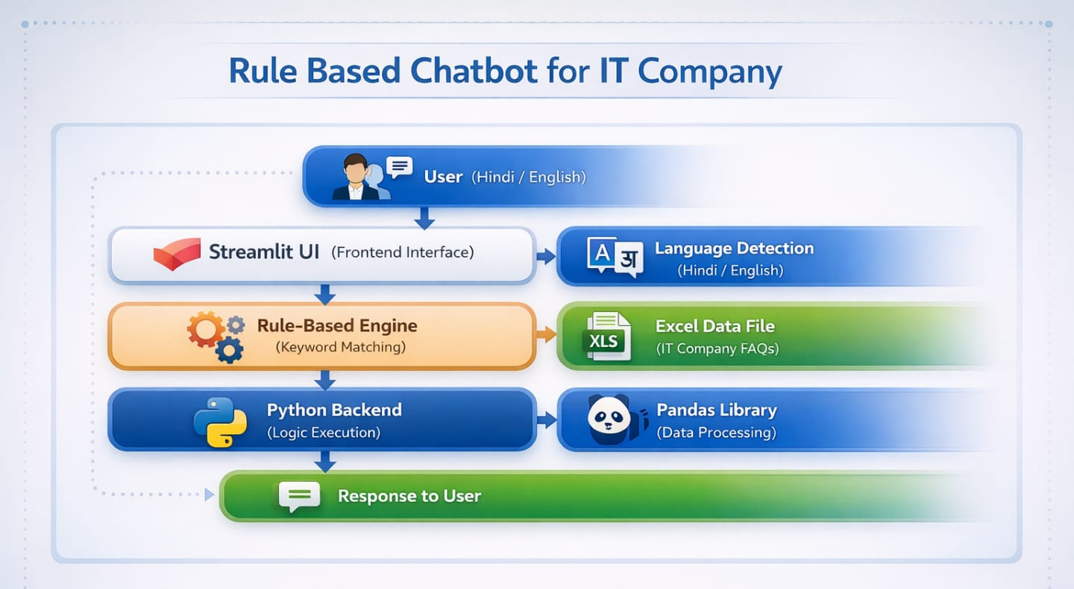
Rule-Based Chatbot
System Architecture / Flow Diagram

Slide 7
Rule-Based Chatbot
Tools, Technologies & Libraries
Programming Language:
Python, HTML , CSS
Framework:
Streamlit (for developing the interactive web application interface)
Libraries:
Pandas – For data handling and CSV-based knowledge management
Regular Expressions (re) – For tokenization and keyword extraction
Development Tools:
Visual Studio Code – Code development
Jupyter Notebook – Data testing and validation
GitHub – Version control and project management
Dataset Source:
Custom-built CSV dataset containing structured FAQ data

Slide 8
Dataset Description :
Type: Custom CSV-based Knowledge Base
Key Columns:
Keywords
  Answer Languages Supported: English and Hindi Language
Handling missing values using fillna()
Data Preprocessing Steps:
Converting text to lowercase for uniformity
Tokenization using Regular Expressions
Stop words removal (English and Hindi)
Keyword-based matching for response generation
Processing Flow:
User Input → Text Processing → Keyword Matching → Response Generation

Slide 9
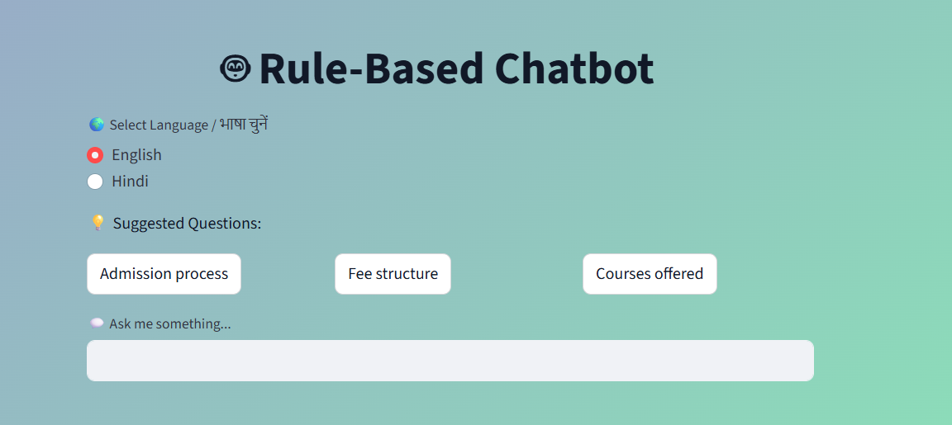
Rule-Based Chatbot
Project Screenshots / Project Designs
Insert UI designs :-

Slide 10
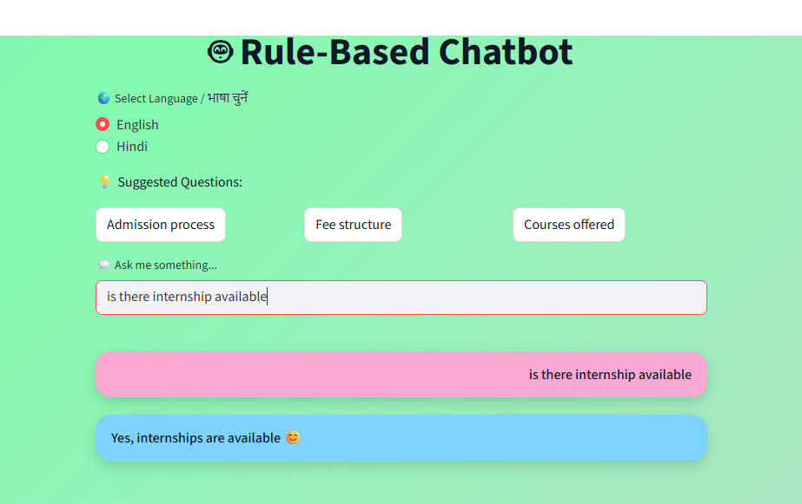
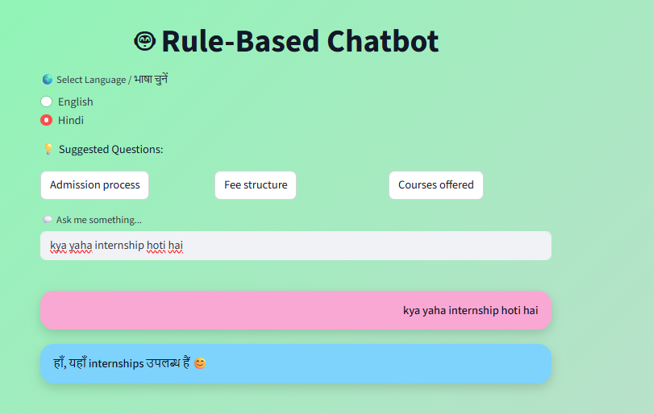
Project Screenshots / Project Designs
Model output Screenshot :- Output in English and Hindi

Slide 11
Rule-Based Chatbot
Results & Performance
Result / Final Outcome
A rule-based IT company internship chatbot was successfully developed. The chatbot provides instant and accurate answers to internship-related queries. It supports a clean and user-friendly interface with bilingual support. The system reduces manual effort and improves information accessibility.
Key findings
Rule-based chatbots are effective for handling frequently asked questions. Keyword matching provides fast and reliable responses. A simple UI improves user engagement and ease of use. The chatbot works efficiently without requiring complex AI models.
Challenges Faced
Handling different user query formats and spellings. Creating accurate keyword–response mapping in the dataset. Designing an attractive yet eye-friendly user interface. Managing limitations of rule-based logic for complex queries.
Future Scope
The chatbot can be extended to support more domains and queries. Integration with databases or APIs for real-time information. Deployment on company websites or mobile applications. Enhancement using machine learning or NLP techniques
Features to be added
Voice-based query support. Advanced NLP-based understanding. Admin panel for dynamic data updates. User authentication and feedback system.

Slide 12

Thank You
Open for Questions
Samsung Innovation Campus

